Slide 1
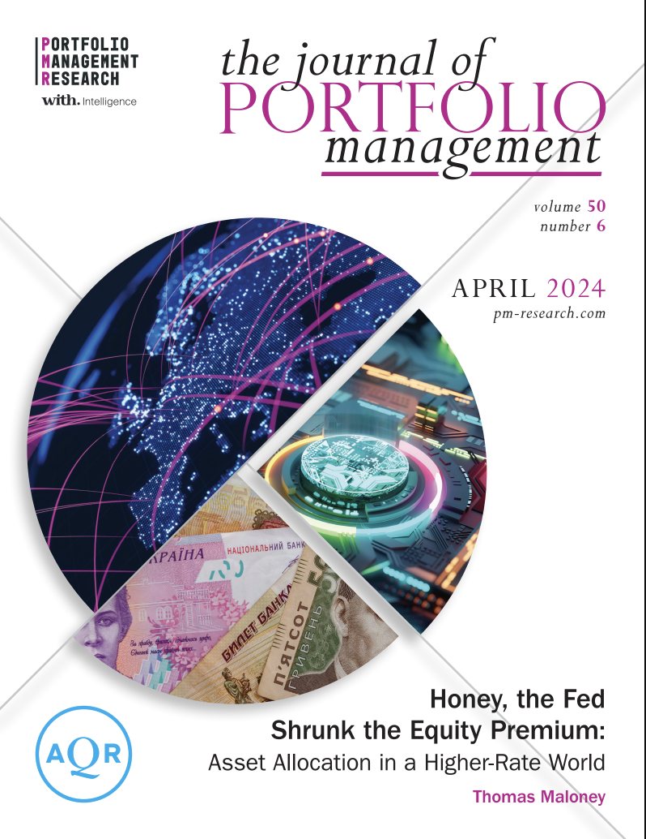
Presenter 1
QF600 ASSET PRICING · GROUP 6
Did the Fed shrink the equity premium, and what should we hold now?
Replicating, testing and backtesting Maloney (2024) on a century of US data
Group 6: Chew Junhong · Marcus Tan Jun Lin · Chia Chong Yee
Abirame d/o Asohan · Ramona Chia Ming Li
QF600 Asset Pricing · Prof Liu Peng · 04 November 2026
Developed with the assistance of Claude by Anthropic
Base paper for our project: Maloney (2024), JPM 50(6)
Notes:
[PRESENTER 1 · 0:00–0:48]
We are Group 6.
Since 2022, cash has paid four to five percent again, and forecasts expect rates to stay about three percentage points above their 2010s level for the next decade.
This raises an important question for investors: if cash and bonds now pay more, should we still allocate as much of our portfolio to stocks?
Our base paper, by Maloney in 2024, argues that we should not, because the equity premium shrinks when interest rates are high.
In this project, we test that claim. We replicate the paper's results, test them out-of-sample, try to disprove them, and then translate the findings into a portfolio allocation.

Slide 2
Presenter 1
SECTION 1 OF 5
01
Summary of paper
What the paper claims, and how we rebuilt its data and method
Summary of paper
Hypothesis
Testing
Findings / Conclusion
Annex
2
Notes:
[PRESENTER 1 · section divider]
No script: click through to the next section.

Slide 3
1
The paper: high rates shrink the equity premium
Presenter 1
Maloney (2024): summary of the paper's findings
1
2
3
Equity risk premium shrinks in higher-rate environments
Private and illiquid assets follow a similar pattern
Liquid alternatives are the standout beneficiaries
Excess returns over cash are slimmer when rates are higher
Seen in both historical data and forward-looking yield estimates
Blitz (2022): earnings have not risen enough to keep the premium constant
Equities and credit: much slimmer premiums when rates are higher
Also clearly seen for private equity and real estate
Equity market-neutral and trend-following strategies: near-zero equity beta over the long term
Comparable excess returns in both rate environments; delivered on their cash-plus objective
Average total returns were substantially higher when rates were higher
3
Notes:
[PRESENTER 1 · 0:48–1:29]
Here is what the paper finds, in three points.
First, the equity premium shrinks when rates are higher. Stocks earned less above cash after higher-rate months, both in history and in forward-looking estimates, because earnings did not grow enough to keep the premium constant.
Second, private assets such as private equity and real estate behave like equities and show the same pattern.
Third, liquid alternatives, such as market-neutral and trend-following funds, earned about the same above cash in both regimes. So in a higher-rate world, these cash-plus strategies gain a relative advantage.

Slide 4
1
Method: the paper's four steps
Presenter 1
Same method, so any difference comes from the data
1
2
3
4
Label each month
Compare returns
Check it isn't luck
Allocate
T-bill above a cut-off. M1: full-history median · M2: past 5 years · M3: 5 years centred.
Stocks' return above cash over the next 1, 12 and 36 months.
Regress next month's return on today's T-bill rate.
For equities and credit, the paper finds statistically significant negative relationships (t-statistics of −2.2 and −2.4 respectively), suggesting the rate-return relationship is unlikely to be pure chance.
Paper suggests portfolios but never backtests them. We do.
OUR EXTENSION
THE PAPER'S DATA
OUR DATA
Monthly 1926–2023, plus a broad set from 1990 with private equity, real estate and hedge funds
Free sources, Jul 1926 – Sep 2026, so we can also test the years after the paper
Paper: regime rules p.4, Exhibit 2 p.5 · regression p.5 · data p.4, p.7 · portfolios Exhibit 9, p.13
4
Notes:
[PRESENTER 1 · 1:29–2:55]
We follow the paper's method, so that any difference in our results comes from the data rather than from a change in the test.
In the first step, we classify each month as high-rate or low-rate by comparing the T-bill rate with a cut-off, using three rules. M1 uses the median of the full history. M2 compares each month with the previous five years. M3 uses a five-year window centred on each month, which means it uses future data.
Most of our results average across all three rules, so that no single definition drives the conclusion. M2 is the only rule without look-ahead bias, so it is the only one an investor could follow in real time, and all of our strategies use it.
In the second step, we compare the average return of stocks above cash over the following 1, 12 and 36 months.
In the third step, we run a predictive regression of next month's return on today's T-bill rate. The paper reports a t-statistic of minus 2.2.
In the fourth step, the paper proposes portfolios for each rate regime, but it never backtests them. Backtesting these portfolios is our extension.

Slide 5
Presenter 1
SECTION 2 OF 5
02
Hypothesis
What we set out to test: H0 to H2, set before seeing any results
Summary of paper
Hypothesis
Testing
Findings / Conclusion
Annex
5
Notes:
[PRESENTER 1 · section divider]
No script: click through to the next section.

Slide 6
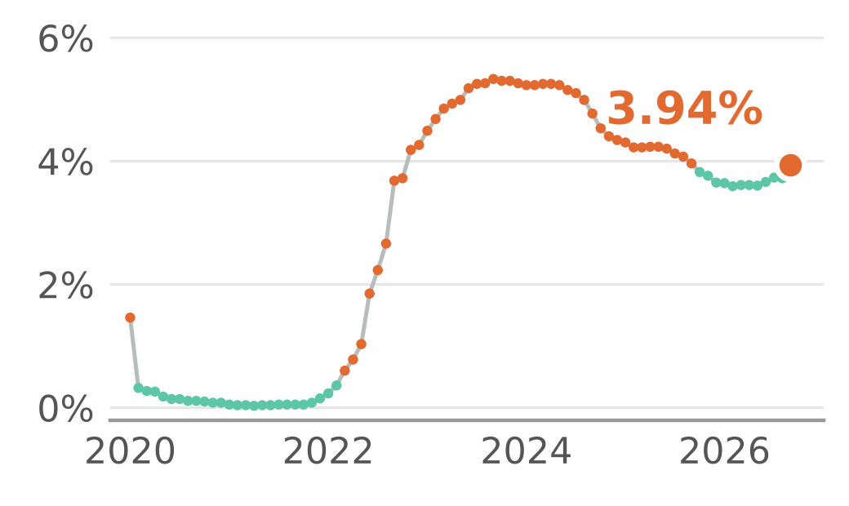
Do high rates shrink stocks' reward?
2
Presenter 1
Reward = stocks' return above cash (T-bills)
WHERE WE ARE TODAY
PART A · IS THE PAPER RIGHT?
3.94%
H0
Rates make no difference
3-month T-bill, Sep 2026: a high‑rate month
H1
After high rates, stocks earn less above cash
PART B · SHOULD AN INVESTOR ACT ON IT?
H2
A big government deficit cancels the effect
T-bill since 2020 · orange = high-rate (M2)
6
Notes:
[PRESENTER 1 · 2:55–4:00]
Throughout this presentation, the reward from stocks means their return above cash, which is the premium investors earn for taking equity risk instead of holding T-bills.
The 3-month T-bill rate is currently 3.94 percent, which counts as a high-rate month, so this question is directly relevant today.
We set our hypotheses before looking at any results.
Part A tests whether the paper is right. The null hypothesis, H0, is that the interest rate level makes no difference. The alternative, H1, is that stocks earn less above cash after high-rate months.
Part B asks whether an investor should act on this. H2 proposes that a large government deficit boosts company profits and cancels out the effect.
If H2 holds, reducing the allocation to stocks when rates are high could be the wrong response.
→ Hand over to Presenter 2

Slide 7
Presenter 2
SECTION 3 OF 5
03
Testing
Data, replication, significance, out-of-sample, deficit test
Summary of paper
Hypothesis
Testing
Findings / Conclusion
Annex
7
Notes:
[PRESENTER 2 · section divider]
No script: click through to the next section.

Slide 8
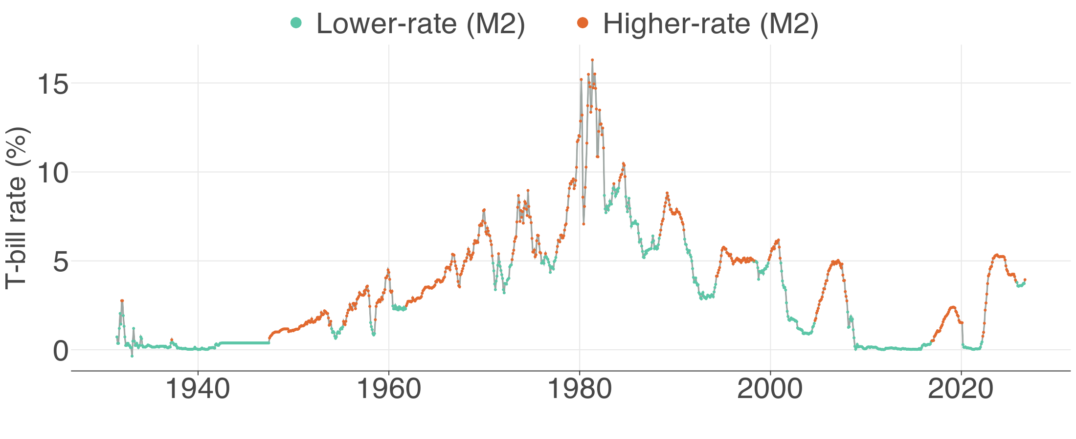
1
A century of rate regimes, from free data
Presenter 2
Rebuilt from free sources, Jul 1926 – Sep 2026
Orange = high-rate under M2, the only rule usable in real time (it only looks back) · T-bill < 0.5% always counts as low
Data: Ken French, FRED, Shiller, Damodaran, World Bank, Yahoo Finance · Jul 1926 – Sep 2026 · Paper: p.4, Exhibit 2 p.5
8
Notes:
[PRESENTER 2 · 4:00–4:29]
The paper relies on a paid database, so we rebuilt the data from free sources, including Ken French, FRED and Shiller. Our bond returns have a correlation of 0.99 with a published series, which gives us confidence in the data.
The chart shows the T-bill rate over a century. The orange points mark high-rate months under M2, the real-time rule that all of our strategies use.

Slide 9
2
Replication: the premium halves after high rates
Presenter 2
Can free data reproduce the paper?
11.1%
above cash, 12 months after LOW rates
5.4%
after HIGH rates (paper: 10.3% vs 5.8%)
■ Bars = paper ◆ Diamonds = our testing Jul 1926 – Dec 2023 · average of M1–M3 · Paper: Exhibit 3, p.6
9
Notes:
[PRESENTER 2 · 4:29–5:12]
Our first task is replication, because if we cannot reproduce the paper's results, nothing that follows would be meaningful.
The bars show the paper's results, and the diamonds show ours.
In the 12 months after a low-rate month, stocks earn 11.1 percent a year above cash. After a high-rate month, they earn only 5.4 percent, so the premium roughly halves.
The paper reports 10.3 and 5.8 percent, so the result reproduces closely with free data.
Corporate bonds show the same pattern, while Treasuries do not. This suggests that the shrinkage affects assets that carry business risk.

Slide 10
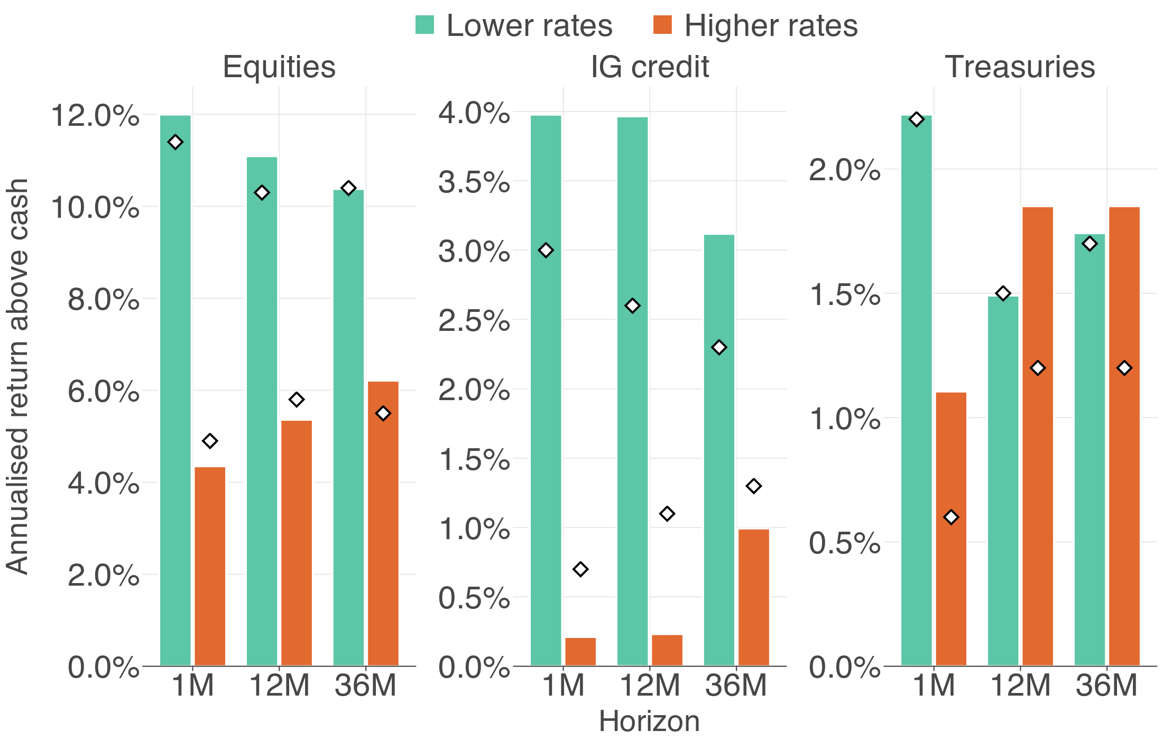
2
Replication: the premium halves after high rates
Presenter 2
Can free data reproduce the paper?
11.1%
above cash, 12 months after LOW rates
5.4%
after HIGH rates (paper: 10.3% vs 5.8%)
Bars = ours, diamonds = paper · Jul 1926 – Dec 2023 · average of M1–M3 · Paper: Exhibit 3, p.6
10
Notes:
[PRESENTER 2 · hidden]
Hidden slide: the same result as the previous slide, shown as an image. Not presented.

Slide 11
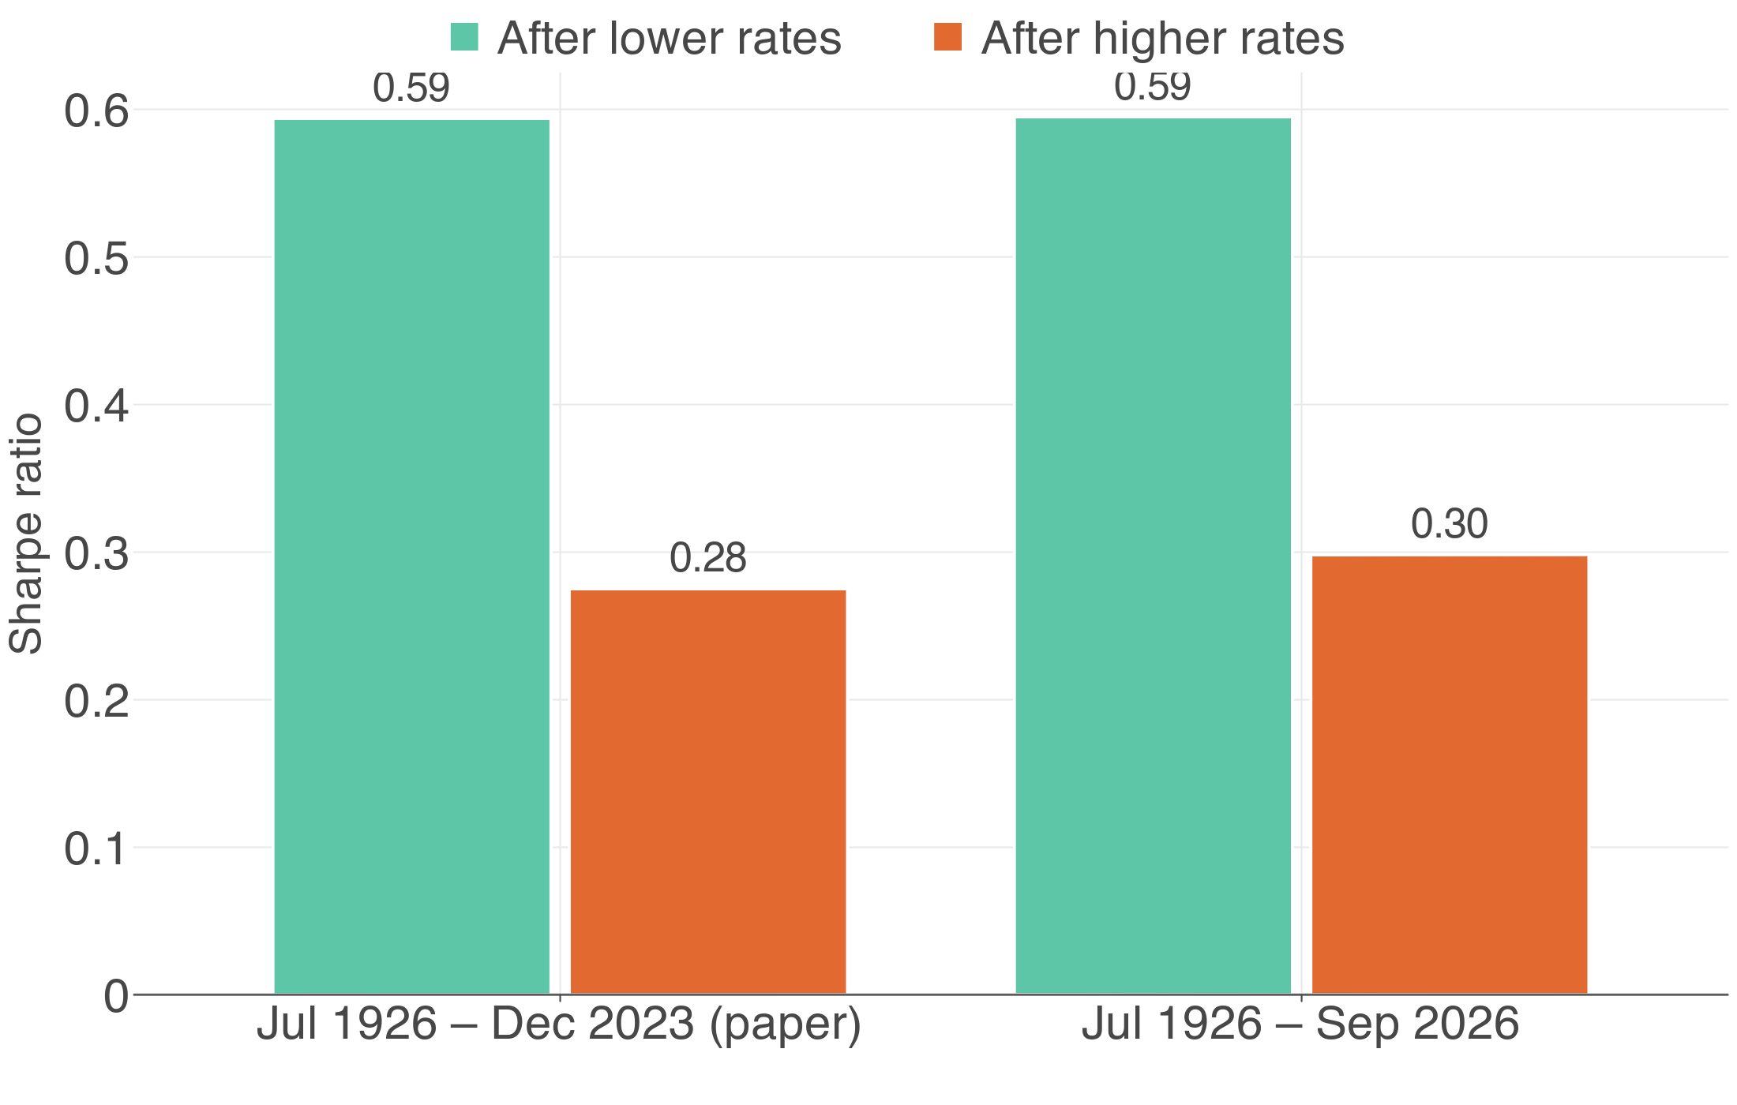
2
Not luck: the gap is statistically significant
Presenter 2
Rates are sticky, so we use Newey-West t-stats
4
of 6 tests reject H0 (3 rules × 2 horizons)
-2.06
t-stat: rate → next return (paper −2.2)
96.7%
chance a high-rate month is followed by another
Chart: T-bill rate and higher-rate months (M2) · Newey-West t-stats, one-sided 5% tests · Paper: t p.5
11
Notes:
[PRESENTER 2 · 5:12–6:56]
Next, we test whether this gap is statistically significant.
A t-statistic is the estimate divided by its standard error. Rate regimes are highly persistent: a high-rate month is followed by another high-rate month 97 percent of the time. This autocorrelation makes ordinary standard errors too small, so we use Newey-West standard errors, which correct for it.
We run two types of test.
The first type is a set of six regime tests, which apply our three rules at two horizons, the next month and the next 12 months. All six gaps are negative, and four of the six are significant at the 5 percent level in a one-sided test, which means a t-statistic below minus 1.645, because H1 predicts a negative gap. M2, the real-time rule, passes only once, and only just.
The second type is the paper's predictive regression. The slope is negative, with a t-statistic of minus 2.06, compared with minus 2.2 in the paper.
Both tests agree that the effect is statistically significant in-sample.
→ Hand over to Presenter 3

Slide 12
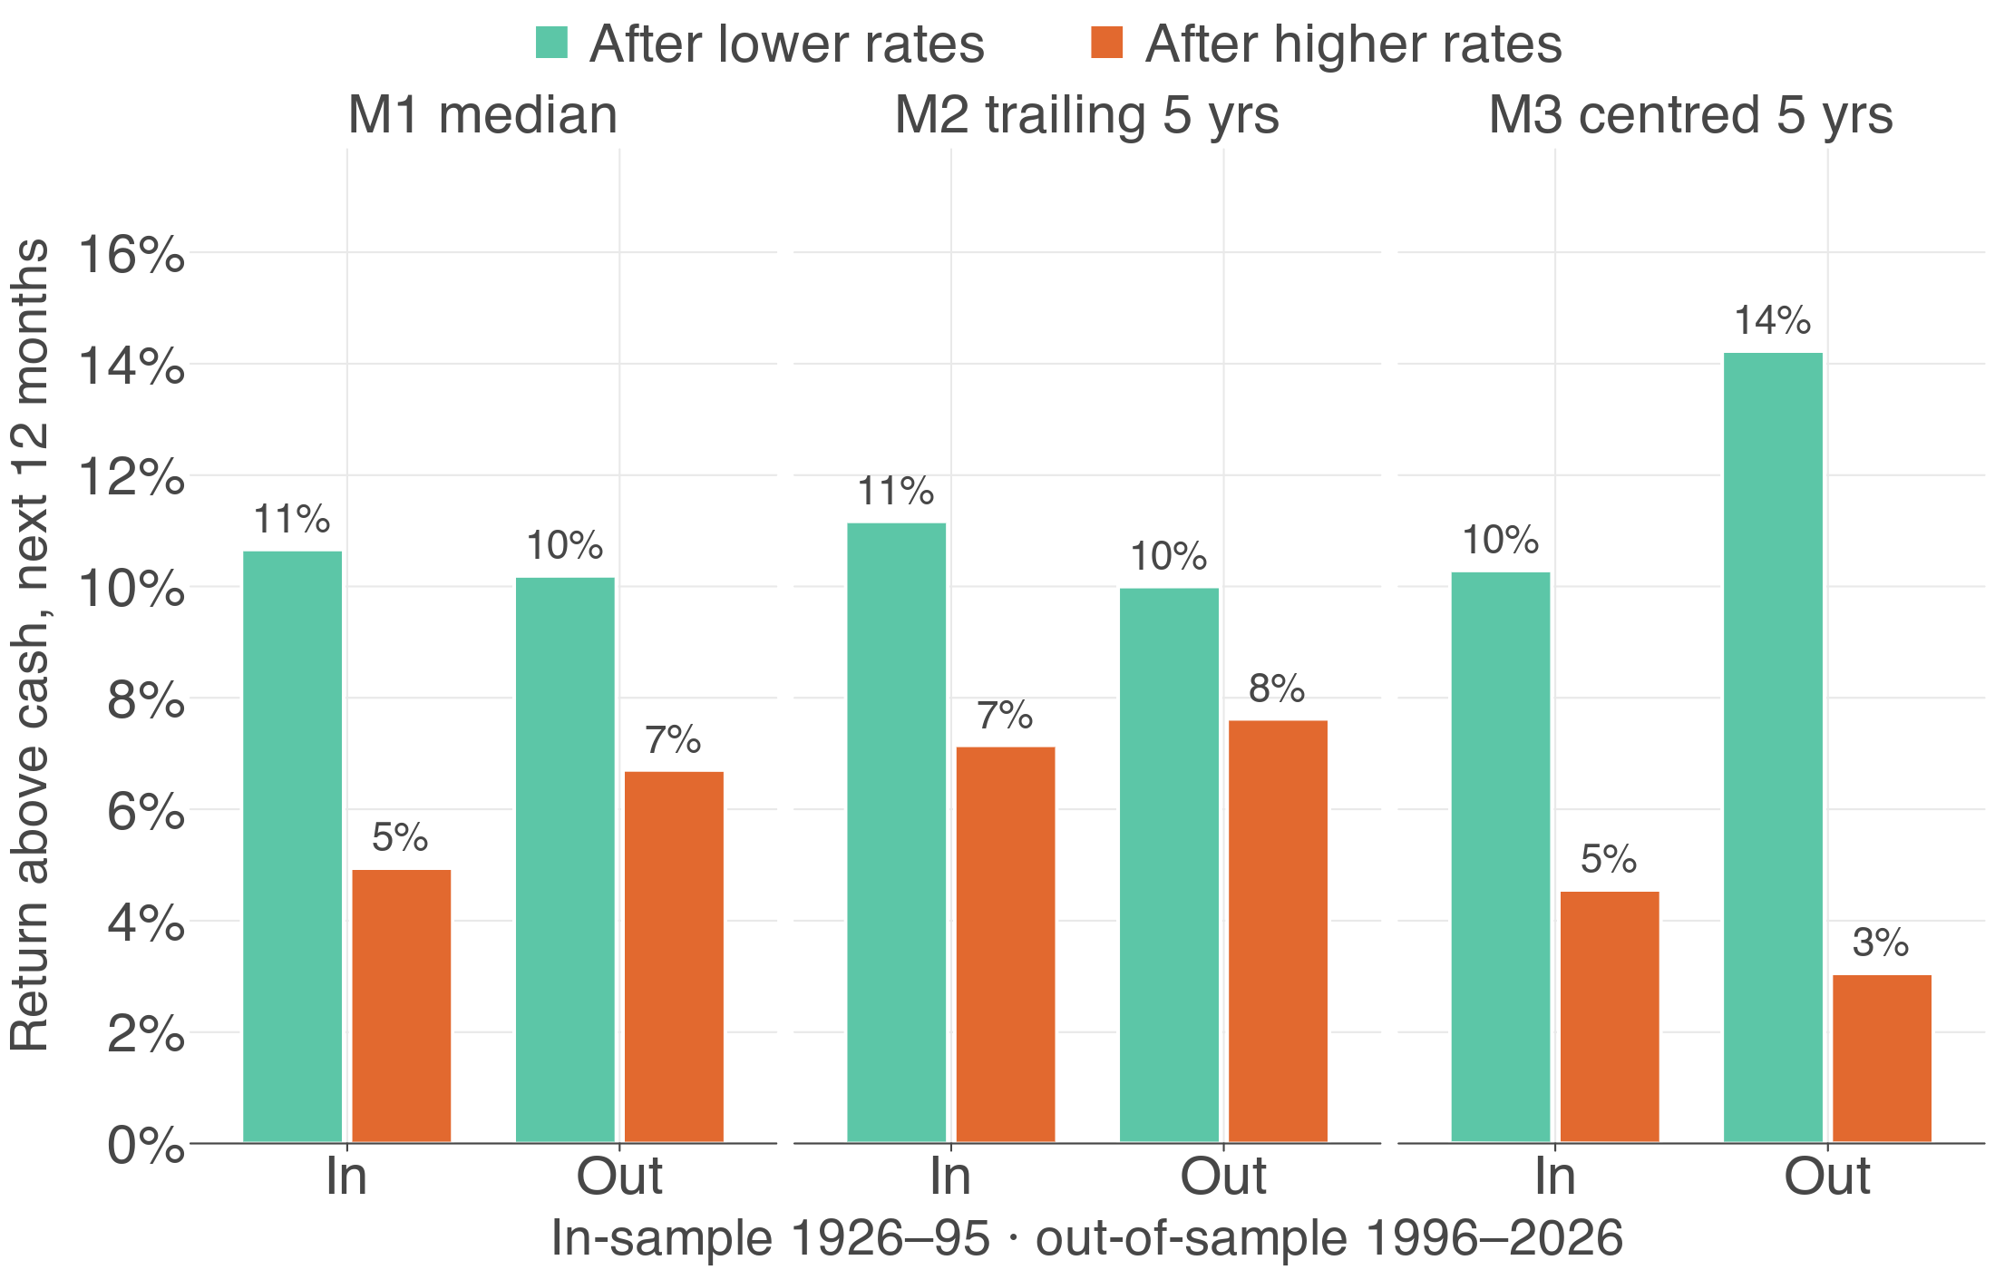
Out of sample: right direction, too weak to trade
3
Presenter 3
70/30 split: in-sample 1926–1995, out-of-sample 1996–2026
2
of 6 reject H0 in-sample (to 1995)
2
of 6 reject H0, out-of-sample 1996–2026
0.15%
out-of-sample R² vs the historical mean
Return above cash over the next 12 months · in-sample Jul 1926 – Dec 1995, out-of-sample Jan 1996 – Sep 2026
12
Notes:
[PRESENTER 3 · 6:56–8:03]
However, in-sample significance does not mean the signal can be traded.
To test this, we split the data roughly 70/30, with an in-sample period from 1926 to 1995 and an out-of-sample period from 1996 to 2026.
The direction of the effect holds in both periods and under all three rules.
The significance, however, does not hold. Only two of the six tests are significant in each period, and both times only under M3, which uses look-ahead information. Under M2, none of the tests are significant.
We also estimated the regression in-sample and used it to forecast the out-of-sample period. The out-of-sample R-squared, which compares the forecast errors with those of the historical mean, is only 0.15 percent. In other words, the rate signal barely improves on simply using the average.
We therefore conclude that the direction of the effect is correct, but the signal is too weak to trade on.

Slide 13
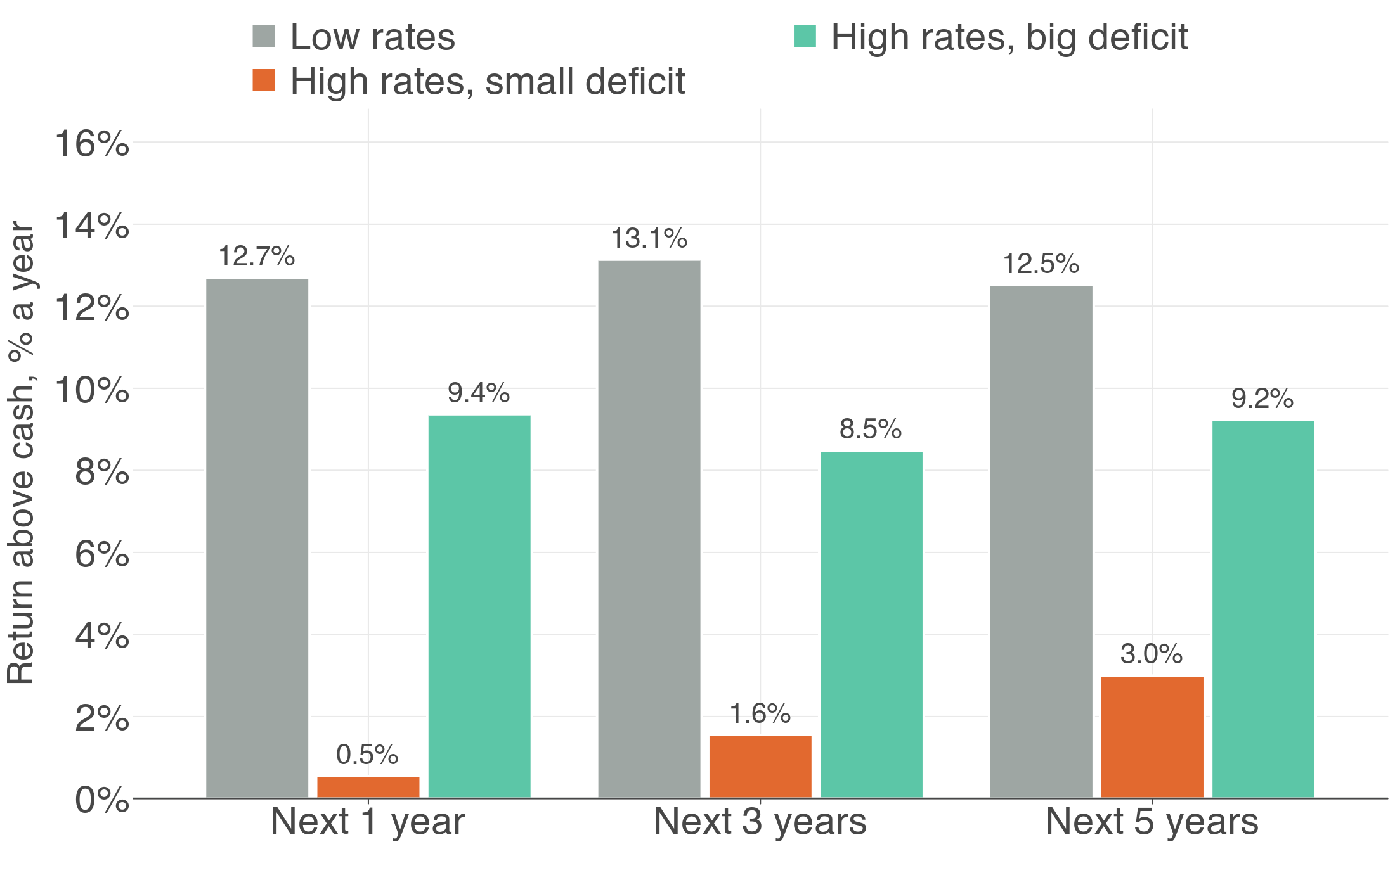
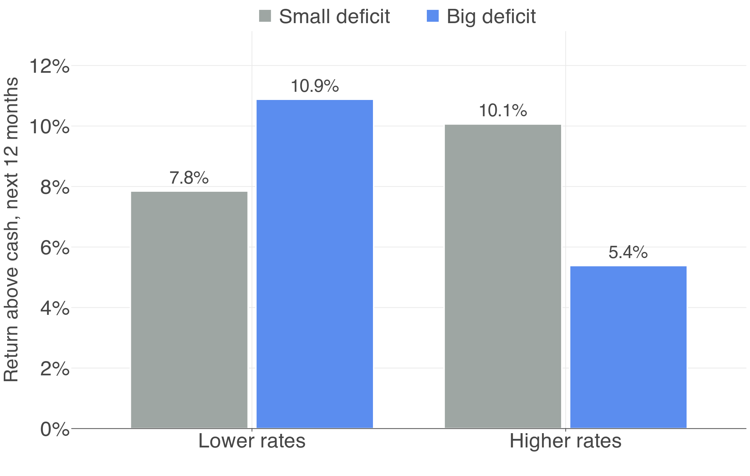
3
Profits stall, but a big deficit offsets most of it
Presenter 3
Deficits add to profits (Kalecki), with a lag of years
13.9%
real earnings growth after LOW rates (paper 11%)
-1.2%
after HIGH rates (paper 1%)
6.2%
big vs small deficit, next 5 yrs, high rates (t = 3.48)
Annual 1929–2025 · high rate: T-bill > 3.07%; big deficit > 2.58% of GDP (medians) · overlapping windows, Newey-West t · Paper: earnings, p.6
13
Notes:
[PRESENTER 3 · 8:03–9:28]
We now look at why the effect occurs, because the mechanism tells us when it might break down.
The paper attributes it to profits. High rates raise borrowing costs and slow spending, so company earnings grow more slowly.
Our data support this. Real earnings grow by 13.9 percent a year after low-rate months, but fall by 1.2 percent after high-rate months.
This leads to our hypothesis H2. Kalecki's profit equation states that government deficits add to company profits, because government spending in excess of tax revenue becomes income for households and firms, and is eventually spent as company sales. A large deficit could therefore offset the effect of high rates, and might explain the strong returns in 2024 and 2025.
We test it on annual data, because the deficit is only published once a year and this channel takes years to reach profits. A year counts as high-rate when the T-bill is above its median of 3.07%, and as a big-deficit year when the deficit is above its median of 2.58% of GDP. We look one, three and five years ahead: one and three years match the paper's horizons, and five years matches our five-year regime window. We start a window every year, so we correct the t-statistics for the overlap.
The data support H2. After high-rate years, stocks earn 9.2% a year above cash over the next five years when the deficit is big, but only 3.0% when it is small. The gap has a t-statistic of 3.48, and 2.82 at three years, so a big deficit offsets about two-thirds of the high-rate penalty.
The result is fragile, though. It needs the full deficit, including interest, and most of the evidence comes from the 1980s, when rates were falling.

Slide 14
Presenter 3
SECTION 4 OF 5
04
Findings / Conclusion
Recent years, what to hold, backtests, conclusion
Summary of paper
Hypothesis
Testing
Findings / Conclusion
Annex
14
Notes:
[PRESENTER 3 · section divider]
No script: click through to the next section.

Slide 15
2024–25 broke the pattern
5
Presenter 3
High rates, yet strong returns. Why?
HIGH RATES, YET STRONG RETURNS
WHY? PARTLY THE DEFICIT, AND…
18.9%
12.8%
+12.1%
Concentration
1
cap- minus equal-weight S&P 500, 2024
above cash, 2024
above cash, 2025
Valuation
2
40.7
CAPE, near its record high
vs 7.0% on average after high-rate months
PARTLY TRUE
VERDICT ON THE PAPER
✓
Real over a century of US data
✓
Same direction out-of-sample, 1996–2026
✗
Too weak to time markets, and it failed in 2024 and 2025
Calendar-year returns above cash; SPY vs RSP; Shiller CAPE · Paper: rate + CAPE predict returns, Exhibit 4, p.7–8
15
Notes:
[PRESENTER 3 · 9:28–10:43]
This leaves the question of 2024 and 2025. Both were high-rate years, yet stocks earned 18.9 and 12.8 percent above cash, well above the 7 percent average after high-rate months.
Part of the answer is the deficit, at about 6 percent of GDP, which our H2 test shows offsets much of the high-rate penalty. Beyond that, we identify two reasons.
The first is concentration. In 2024, the cap-weighted S&P 500 outperformed its equal-weighted version by 12.1 percent, which shows that a small number of very large firms drove the market's return.
The second is valuation. The CAPE ratio, which is price divided by the ten-year average of real earnings, is 40.7. This is close to its record high and well above its long-run average of about 17. The paper shows that interest rates and CAPE jointly predict returns, and both are significant in our data as well. Together, they point to lower returns ahead.
Our verdict is that the paper is partly true. The effect is statistically significant over a century and keeps its direction out-of-sample. However, it is too weak to time the market with, and it failed in 2024 and 2025.
→ Hand over to Presenter 4

Slide 16
High rates: gold, momentum protect; bonds don't
5
Presenter 4
If timing fails, what should sit alongside stocks?
SHARPE RATIO IN HIGH-RATE MONTHS
CORRELATION WITH STOCKS, RATES RISING
60/40
0.29
Bonds
0.28
50/50
0.28
Momentum
0.05
Equal weight
0.68
Gold
0.02
50/50 lowers risk, not the Sharpe ratio: you just give up return.
Adding gold and momentum more than doubles it.
3.5%
equal-weight CVaR 5% in high-rate months (60/40 higher)
Bonds fall with stocks when rates rise (as in 2022).
Equal weight = stocks, bonds, gold, momentum
Monthly, Feb 1960 – Sep 2026 · momentum = T-bill + UMD · Paper: liquid alternatives, Exhibit 6, p.10
16
Notes:
[PRESENTER 4 · 10:43–12:09]
Since interest rates cannot reliably time the stock market, the more useful question is which assets an investor should hold alongside stocks.
We use four assets over 1960 to 2026: stocks, bonds, gold and momentum. Momentum is a strategy that buys recent winners and sells recent losers, so its returns do not depend on the market rising.
A common response to high rates is to move from a 60/40 portfolio to 50/50. This lowers risk, but it does not improve the Sharpe ratio, which stays at about 0.29 versus 0.28. The investor simply gives up return in proportion to the risk removed.
By contrast, holding all four assets in equal weights more than doubles the Sharpe ratio, to 0.68.
The reason is correlation. When rates are rising, bonds tend to move with stocks, with a correlation of 0.28, as we saw in 2022. Gold and momentum stay close to zero, at 0.02 and 0.05, so they provide diversification when bonds do not.
Tail risk tells the same story. CVaR, which measures the average loss in the worst 5 percent of months, is 3.5 percent for the equal-weighted portfolio in high-rate months, lower than for 60/40.

Slide 17
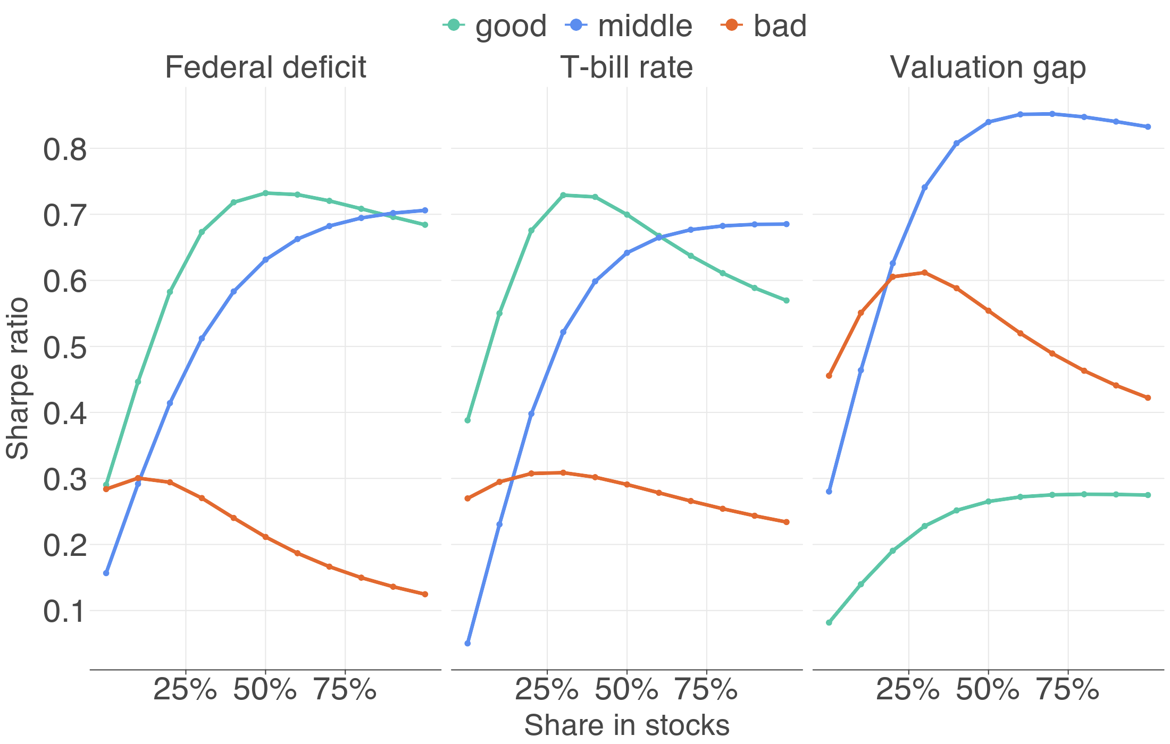
How much in stocks today? About 60%
5
Presenter 4
Mean-variance: w* = premium ÷ (A × variance)
144%
w* after LOW rates (A = 3)
66%
w* after HIGH rates: halved, not zero
60%
our pick: w* plus the chart's sorts
Chart: Sharpe of stock/bond mixes in good, middle, bad thirds of history · Feb 1960 – Sep 2026 · Paper: Exhibits 8–9, p.11–13
17
Notes:
[PRESENTER 4 · 12:09–13:35]
Next, we determine what weight an investor should allocate to stocks in the portfolio.
Mean-variance analysis gives the optimal weight in stocks, w-star, as the equity premium divided by the product of risk aversion and variance. A higher premium leads to a higher weight in stocks, while higher risk or higher risk aversion leads to a lower weight.
With a risk aversion coefficient of 3, the optimal weight is 144 percent after low-rate months, which implies borrowing to invest, and 66 percent after high-rate months.
The exact level depends on the risk aversion we choose, but the halving does not, because the premium halves while volatility barely changes.
As a cross-check, we sort history into terciles using three signals: the T-bill rate, valuation and the deficit. Within each tercile, we find the stock and bond mix with the highest Sharpe ratio. For the terciles that match today's conditions, the optimal stock weights are 100, 30 and 50 percent.
Together with the 66 percent from mean-variance, these estimates average in the low 60s. We therefore recommend allocating about 60 percent of the portfolio to stocks, which is lower than before, but far from zero.

Slide 18
Each finding becomes a strategy we can backtest
3
Presenter 4
Can an investor profit? Each rule uses only past data
B
Benchmark
S1
Paper
S2
Rate rule
SPY, IEF, GLD and PDP in equal amounts, never rebalanced
The paper's low- and high-rate portfolios (Exhibit 9)
70/30 stocks/bonds; 50/50 when rates are high
TESTS Simple diversification: the bar to beat
TESTS The paper's own advice
TESTS Cut stocks after high rates (H1)
F
Fixed mixes
S3
+ Deficit
S4
Ridge MV
100/0, 70/30, 60/40, 50/50 and 1/N, rebalanced
As S2, but 60/40 when the deficit is big
Mean-variance weights per regime, shrunk with ridge
TESTS Does de-risking to 50/50 help?
TESTS Deficit offset (H2)
TESTS Gold and momentum protect at high rates
SPY stocks · IEF bonds · GLD gold · PDP momentum · regime = M2 at last month-end · 10 bps costs · S1: paper Exhibit 9, p.13
18
Notes:
[PRESENTER 4 · 13:35–14:40]
To test whether an investor could have profited from these findings, we turn each one into a strategy.
The benchmark, B, holds stocks, bonds, gold and momentum in equal amounts and is never rebalanced. It is the simplest diversified portfolio.
S1 holds the portfolios suggested in the paper.
S2 follows the paper's logic: it holds 70 percent in stocks normally, and reduces this to 50 percent when rates are high.
The fixed mixes, such as 60/40, represent what most investors actually hold.
S3 adds our deficit signal to S2.
S4 uses mean-variance weights for each rate regime. Because raw optimisers overreact to estimation error, we apply ridge regularisation, which shrinks the weights toward an equal split.
All strategies use only information available at the end of the previous month, so there is no look-ahead bias. They rebalance monthly and pay 10 basis points in trading costs.
→ Hand over to Presenter 5

Slide 19
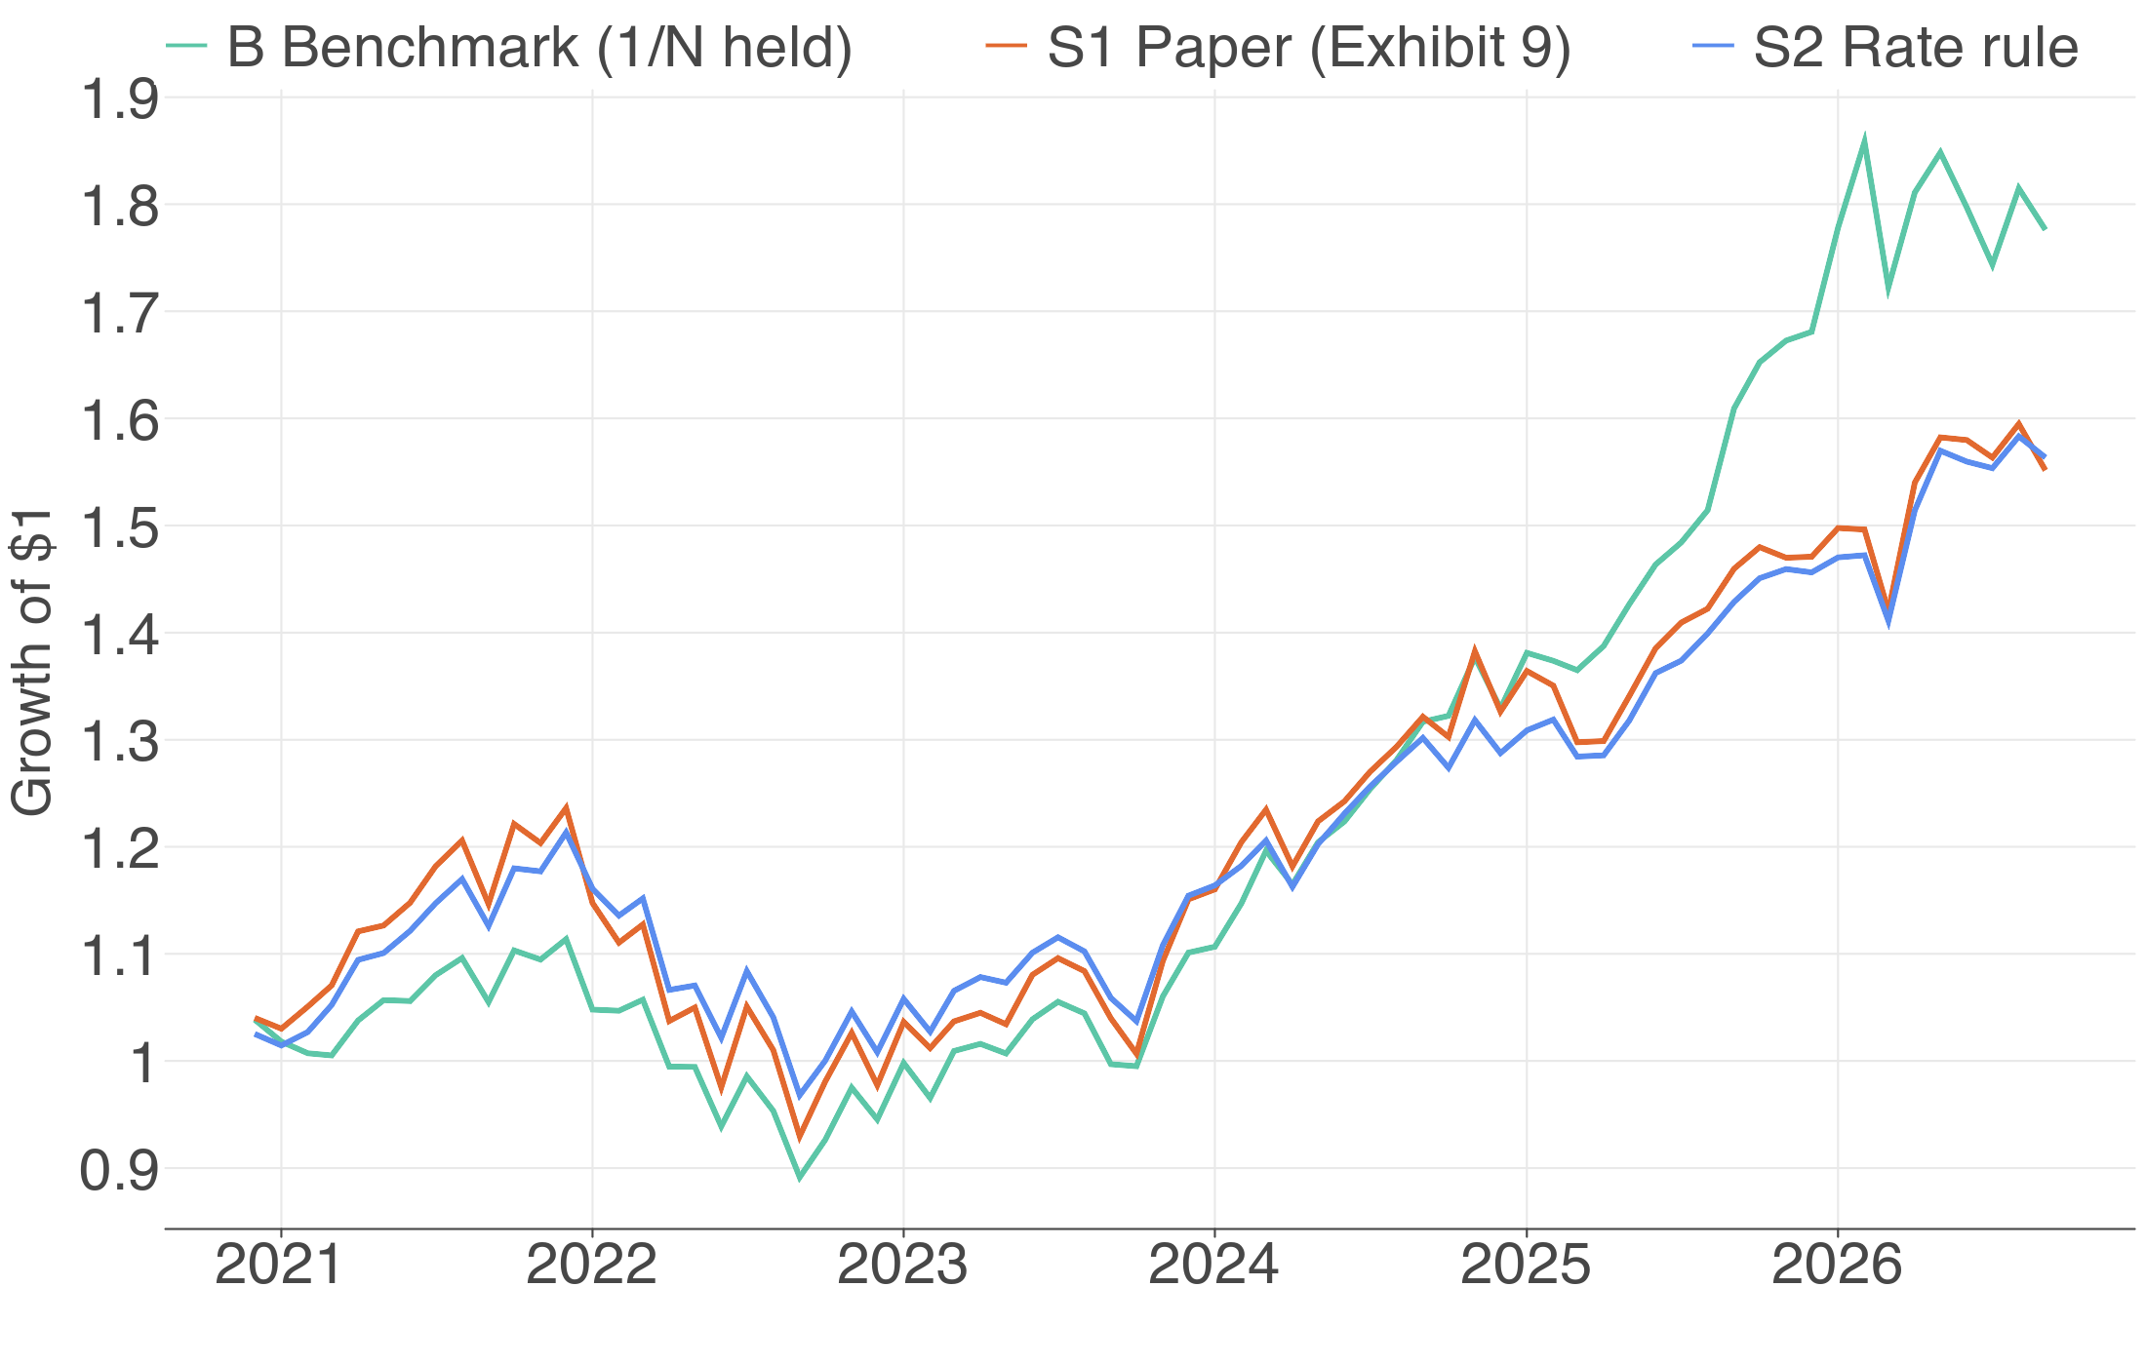
The paper's own advice lags simple diversification
4
Presenter 5
70/30 split: in-sample May 2007 – Nov 2020, out-of-sample Dec 2020 – Sep 2026
0.65
out-of-sample benchmark Sharpe
0.40
S1, the paper's portfolios
0.48
S2 rate rule (0.81 in-sample)
Growth of $1, Dec 2020 – Sep 2026 · 10 bps costs · S1 = paper Exhibit 9, p.13
19
Notes:
[PRESENTER 5 · 14:40–15:30]
The backtest uses real ETFs from 2007 onwards, with a 70/30 split between in-sample and out-of-sample periods. All parameters are chosen in-sample, from May 2007 to November 2020, and performance is measured out-of-sample, from December 2020 to September 2026, which covers the recent high-rate years.
The benchmark achieves an out-of-sample Sharpe ratio of 0.65.
The paper's portfolios achieve only 0.40, because their listed private equity and real estate holdings behaved like leveraged equity.
The rate rule falls from a Sharpe ratio of 0.81 in-sample to 0.48 out-of-sample, because it reduced its stock allocation just before the 2023 to 2025 rally.
In practice, therefore, following the paper's advice would have underperformed simple diversification.

Slide 20
Out of sample, only S4 and 100% stocks beat B
4
Presenter 5
No alpha is significant (all |t| < 2)
Strategy
Alpha
t
Beta
Return
Vol.
Var.
Sharpe
CVaR 5%
Max DD
Turn.
B Benchmark
—
—
—
10.4%
11.6%
0.0135
0.65
6.4%
-20.0%
0.00
S1 Paper
-2.28%
-0.86
1.02
7.8%
13.2%
0.0174
0.40
7.6%
-24.8%
0.41
S2 Rate rule
-0.90%
-0.39
0.81
8.0%
10.6%
0.0113
0.48
5.8%
-20.2%
0.31
100/0
4.02%
1.19
1.10
15.2%
15.0%
0.0224
0.82
8.0%
-23.9%
0.00
70/30
0.28%
0.12
0.90
9.8%
11.8%
0.0138
0.59
6.5%
-21.4%
0.16
60/40
-0.96%
-0.47
0.83
8.0%
10.8%
0.0116
0.49
5.9%
-20.5%
0.18
50/50
-2.20%
-1.22
0.76
6.3%
9.9%
0.0097
0.35
5.5%
-19.7%
0.19
1/N rebal.
-0.28%
-0.66
0.95
9.7%
11.1%
0.0122
0.62
6.0%
-19.3%
0.30
S3 + Deficit
-0.31%
-0.13
0.85
8.9%
11.2%
0.0124
0.54
6.1%
-20.8%
0.23
S4 Ridge MV
2.69%
1.31
0.88
12.3%
11.5%
0.0133
0.81
6.3%
-22.6%
0.62
Dec 2020 – Sep 2026, after 10 bps costs · alpha, beta vs B (Newey-West t) · CVaR = avg monthly loss, worst 5% · in-sample in Annex A
20
Notes:
[PRESENTER 5 · 15:30–16:54]
This table shows the full out-of-sample results. Alpha and beta come from regressing each strategy's excess return on the benchmark's excess return. Beta measures the strategy's exposure to the benchmark, and alpha is the return the benchmark cannot explain.
There are three main findings.
First, fixed mixes are not stable. The 50/50 portfolio had the best in-sample Sharpe ratio, 0.92, but the worst out-of-sample. Moving to 50/50 when rates rise is therefore not a reliable solution.
Second, strategies that time the stock allocation using interest rates, S2 and S3, underperform the benchmark.
Third, only two strategies outperform the benchmark: 100 percent stocks, which benefited from the large-cap technology rally, and S4, which reaches a Sharpe ratio of 0.81 by shifting into gold and momentum rather than bonds when rates are high.
However, S4's alpha has a t-statistic of 1.31, so it is not statistically significant, and part of its performance comes from gold's strong rally.
We also controlled for overfitting. When we tuned S4's ridge penalty on the full in-sample period, it achieved 1.17 in-sample but only 0.47 out-of-sample. We therefore switched to walk-forward validation within the in-sample period.

Slide 21
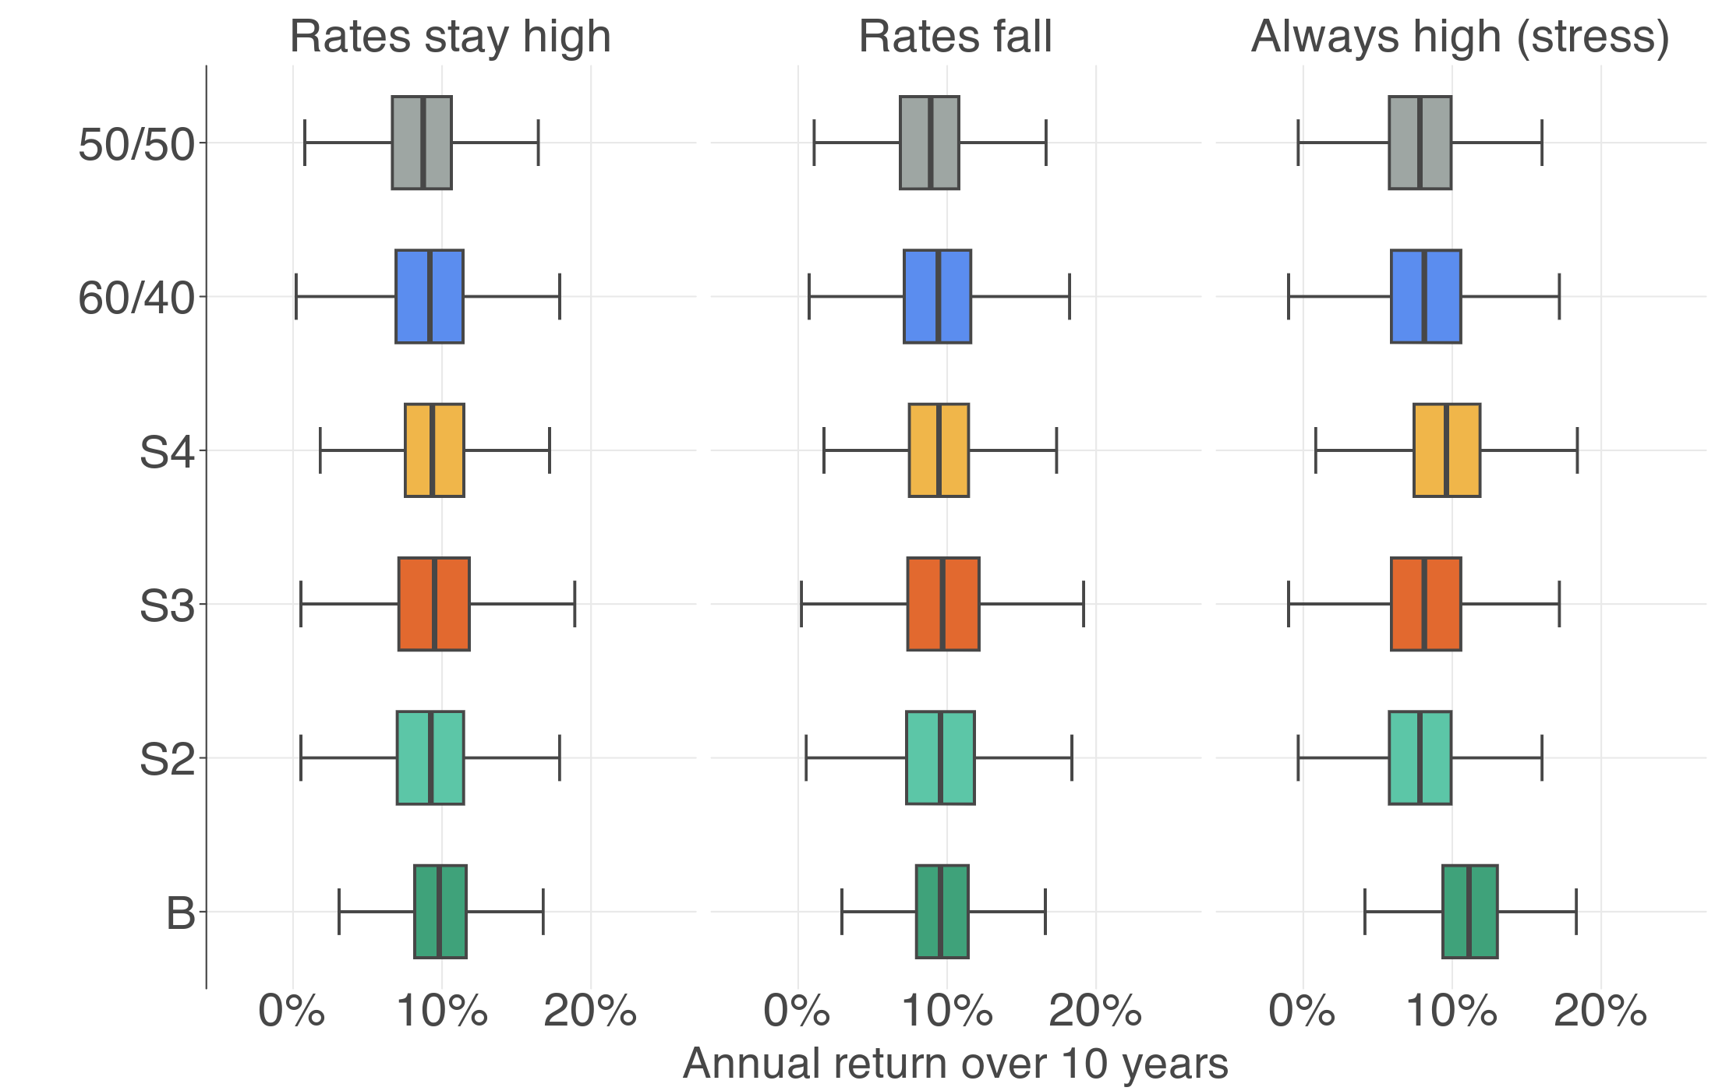
Next 10 years: diversified portfolios hold up best
4
Presenter 5
Six years is one path, so we simulate 2,000 futures
9.8%
benchmark, rates stay high
8.7%
50/50, rates stay high (60/40: 9.2%)
7.8%
rate rule if rates never fall
2,000 simulated 10-year paths · regime switching counted from history · months drawn from 1960–2026
21
Notes:
[PRESENTER 5 · 16:54–17:56]
Since six years of out-of-sample data represent only one possible path, we also simulate possible future outcomes.
We estimate regime transition probabilities from history, following the method in our CVaR reference paper, and run a Monte Carlo simulation of 2,000 ten-year paths. Each simulated month draws a historical month from the same rate regime.
Each box shows the middle half of the simulated outcomes, and the line inside it marks the median.
If rates stay high, the benchmark's median return is 9.8 percent a year. The 50/50 portfolio earns 8.7 percent, compared with 9.2 percent for 60/40, so reducing stocks in favour of bonds lowers returns.
If rates never fall, the rate rule's return drops to 7.8 percent, because it remains at 50/50, while the diversified portfolios hold up.
The main limitation is that a bootstrap simulation can only resample history.

Slide 22
✓
Conclusion: 60% stocks, diversify beyond bonds
Presenter 5
High rates shrink the reward, but timing doesn't pay
CENTRAL MESSAGE
Being in the middle doesn't mean retreating to risk-free. Hold about 60% in stocks; when rates are high, diversify with gold and momentum, not bonds alone.
60%
0.81
0.15%
in stocks, plus bonds, gold, momentum
S4 out-of-sample Sharpe (not significant)
out-of-sample R²: too weak to time
NEXT STEPS
1
Real cash-plus funds as their history grows
2
Add valuation (CAPE) to the rate rule
3
Test other countries
Coursework only. Past returns do not predict future returns. Not investment advice. Prepared with the assistance of Claude (Anthropic); all results were checked by the Group.
22
Notes:
[PRESENTER 5 · 17:56–18:54]
In conclusion, high interest rates do shrink the equity premium. A big government deficit offsets much of this, but that evidence is fragile.
However, the signal is too weak to time the allocation to stocks, and shifting from stocks to bonds did not pay off out-of-sample.
What changes in a high-rate environment is which assets provide diversification.
There are two caveats. The out-of-sample period is under six years and benefited from gold's rally, and the investable momentum fund is more correlated with stocks than the momentum factor itself.
Our recommendation is that being in the middle does not mean retreating to risk-free assets. Investors should keep about 60 percent of the portfolio in stocks and, when rates are high, diversify with gold and momentum rather than relying on bonds alone.
Thank you.

Slide 23
Presenter 5
SECTION 5 OF 5
05
Annex
Backup slides: full tables and tuning detail
Summary of paper
Hypothesis
Testing
Findings / Conclusion
Annex
23
Notes:
[PRESENTER 5 · section divider]
No script: click through to the next section.

Slide 24
A
Annex A: all strategies, in-sample metrics
Presenter 5
Strategy
Alpha
t
Beta
Return
Vol.
Var.
Sharpe
CVaR 5%
Max DD
Turn.
B Benchmark
—
—
—
7.8%
9.8%
0.0096
0.74
5.8%
-22.2%
0.00
S1 Paper
0.51%
0.16
1.03
8.0%
14.0%
0.0195
0.57
9.8%
-49.0%
0.44
S2 Rate rule
2.55%
1.31
0.75
8.6%
9.8%
0.0097
0.81
6.2%
-32.7%
0.38
100/0
0.93%
0.27
1.12
9.0%
15.7%
0.0246
0.58
10.0%
-50.8%
0.07
70/30
1.82%
0.88
0.81
8.2%
10.5%
0.0111
0.73
6.8%
-35.4%
0.28
60/40
2.12%
1.29
0.71
7.9%
8.9%
0.0079
0.82
5.8%
-29.5%
0.31
50/50
2.42%
1.92
0.61
7.6%
7.4%
0.0055
0.92
4.8%
-23.1%
0.32
1/N rebal.
0.83%
1.03
0.95
8.4%
9.6%
0.0093
0.81
5.7%
-25.7%
0.38
S3 + Deficit
2.35%
1.20
0.78
8.6%
10.1%
0.0102
0.79
6.4%
-32.7%
0.37
S4 Ridge MV
3.00%
1.24
0.98
10.7%
11.8%
0.0140
0.86
7.1%
-39.0%
0.53
May 2007 – Nov 2020, after 10 bps costs · alpha, beta vs B (Newey-West t)
24
Notes:
[BACKUP]
Backup, if asked.
This table shows all strategies in-sample, from May 2007 to November 2020. Every strategy looked better before the test period, especially the 50/50 portfolio at 0.92 and the rate rule at 0.81.

Slide 25
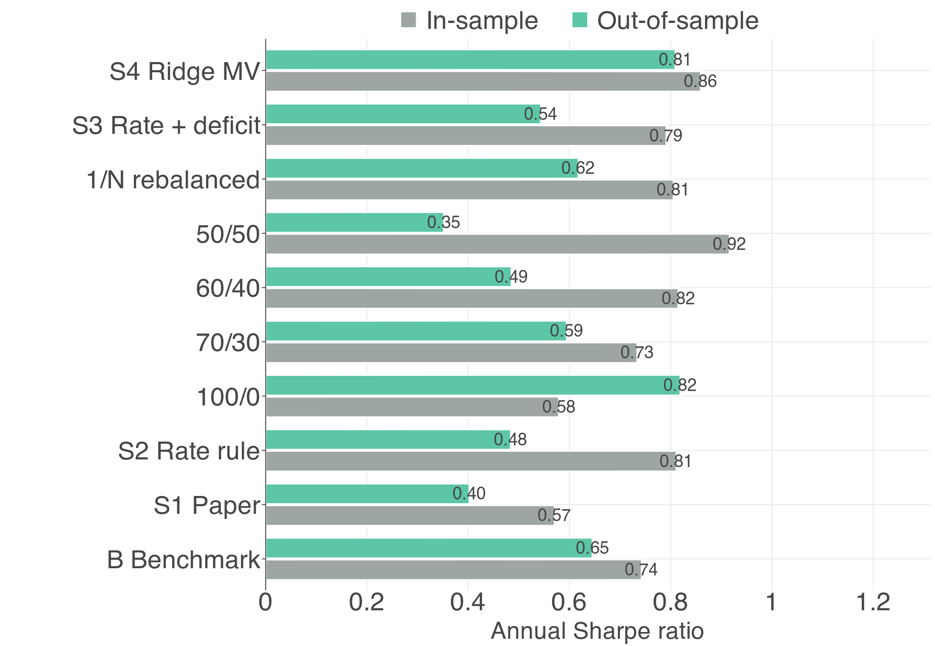
B
Annex B: Sharpe ratios and S4 tuning
Presenter 5
Ridge η
Validation Sharpe
0.01
1.13
0.05
1.22
0.1
1.26
0.5
1.29
1
1.29
2
1.29
5
1.29
10
1.29
20
1.29
S4: train on an expanding window from May 2007, validate on the next 12 months, 4 windows; η with the best average, refit on all in-sample data
25
Notes:
[BACKUP]
Backup, if asked.
The left panel shows Sharpe ratios in both periods. The right panel shows how we chose S4's ridge penalty using walk-forward validation: we trained on an expanding window, scored each penalty on the next 12 months, rolled forward four times, and kept the penalty with the best average score.
The score is flat above 0.5, so the choice is not sensitive to the exact value.

Slide 26
C
Annex C: replication and the deficit test (H2)
Presenter 5
26
Notes:
[BACKUP]
Backup, if asked.
This slide shows the full replication of the paper's main result and the deficit test in detail. The deficit result holds with overlapping windows, but weakens with non-overlapping ones (t = 2.00 at five years), without the 1980s (t = 1.54), and disappears at three years with the primary deficit or a cut-off known at the time.

